Slide 1
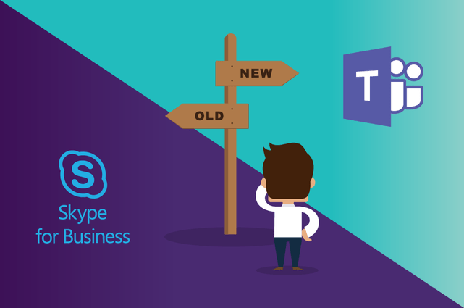
Consumer Electronics accessory company – Skype for Business to Microsoft Teams Migration
Client Need
Affirma worked with this Client to migrate a thousand users from Skype for Business to Microsoft Teams and provided guidance on governance and change management.
What We Did
Governance discovery and planning
Short timeline
User adoption focused
Result:
Successfully transitioned the organization
“I thought talking about Governance would be boring, but it’s actually pretty fun! Thanks for your efforts and perspective!” – Sr. IT Project Manager.

